Slide 1
Demonstration of Load Balancer using Group Chat Application

Slide 2
Group members:
IN GUIDENCE OF Mrs. Deepti singh
name
batch
Enrollment No.
Sarthak sehghal
B-11
15104023
15104005
Anshul jain
B-11
15104002
Abhishek tiwari
B-11

Slide 3

Home-Page

Slide 4
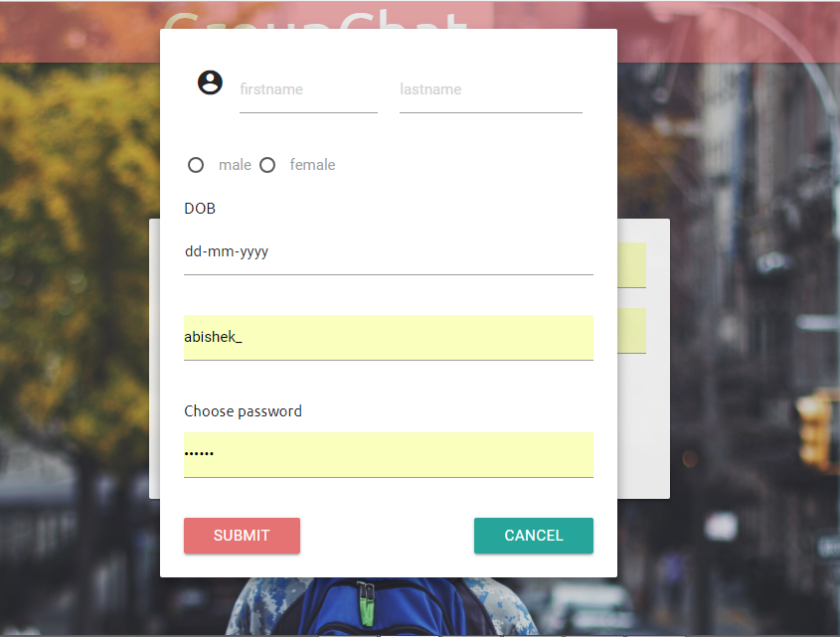
Sign-up:

Slide 5
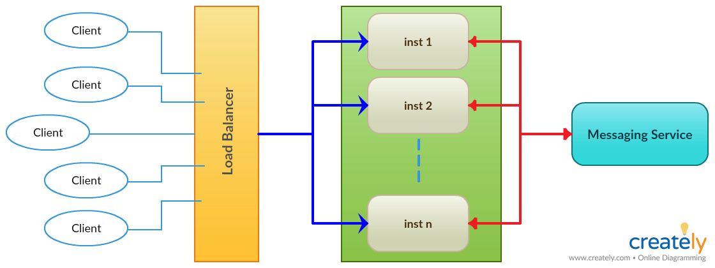
Functionality Diagram

Slide 6
SEQUENCE DIAGRAMS

Slide 7
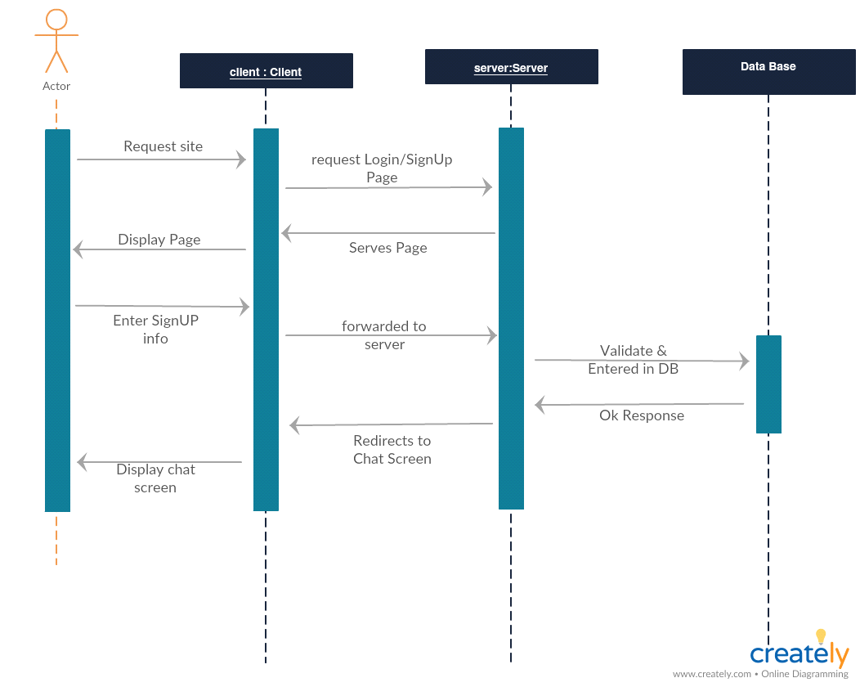
Client sign-up

Slide 8
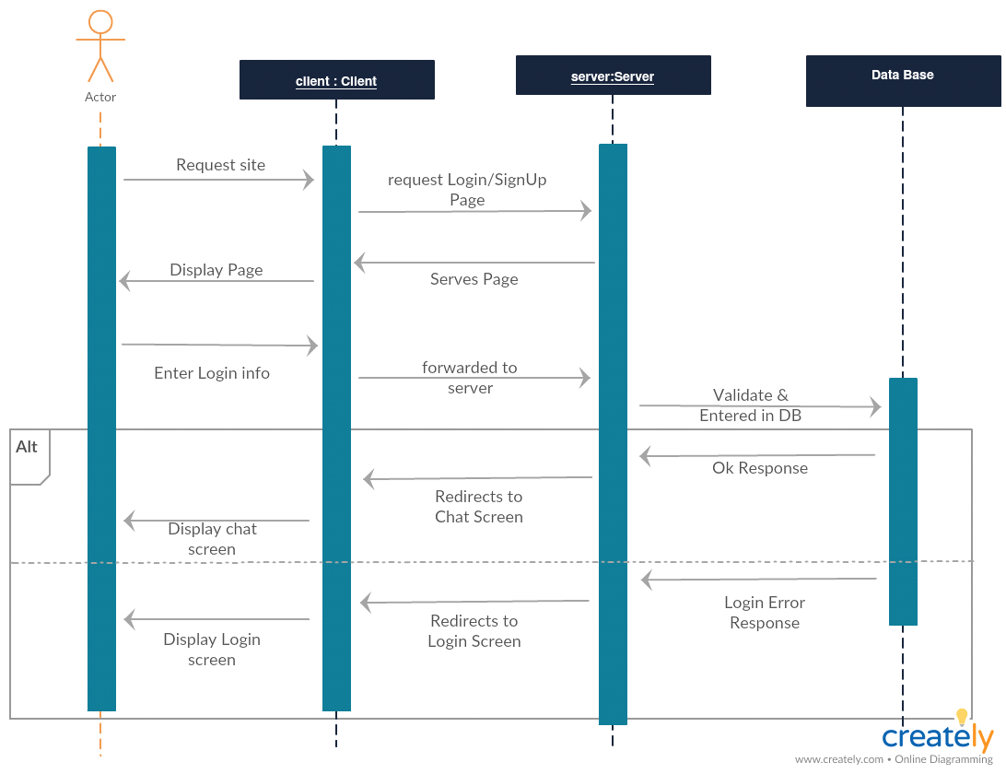
Client login

Slide 9
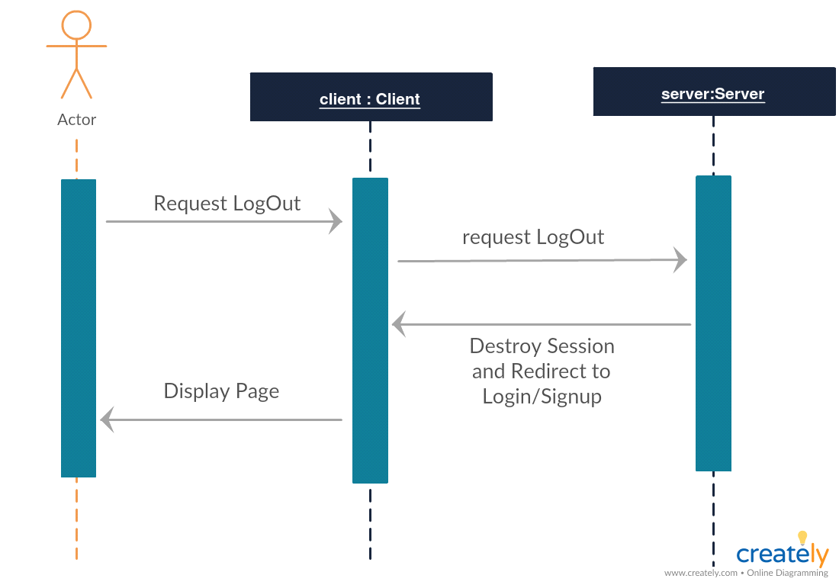
logout

Slide 10
USE CASE DIAGRAM

Slide 11
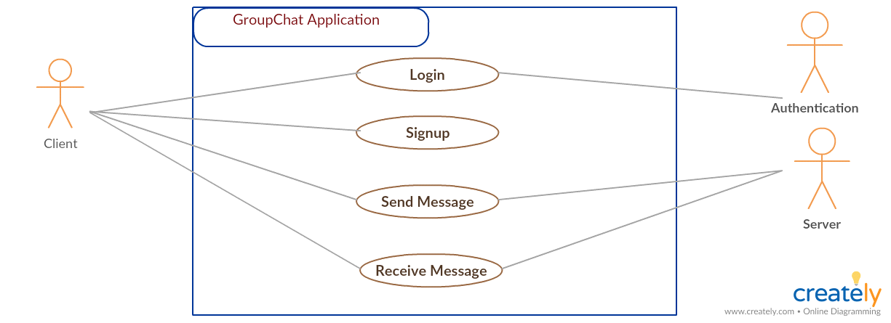

Slide 12
ER-diagram

Slide 13
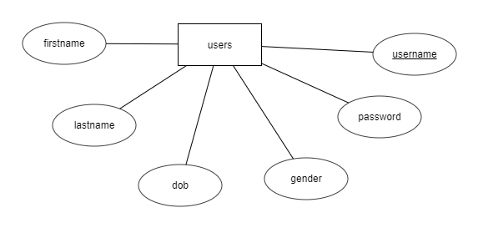

Slide 14
results

Slide 15
case-1

Slide 16
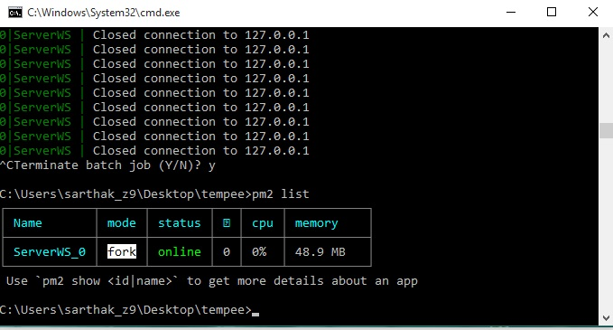
single instance of server without load balancer

Slide 17
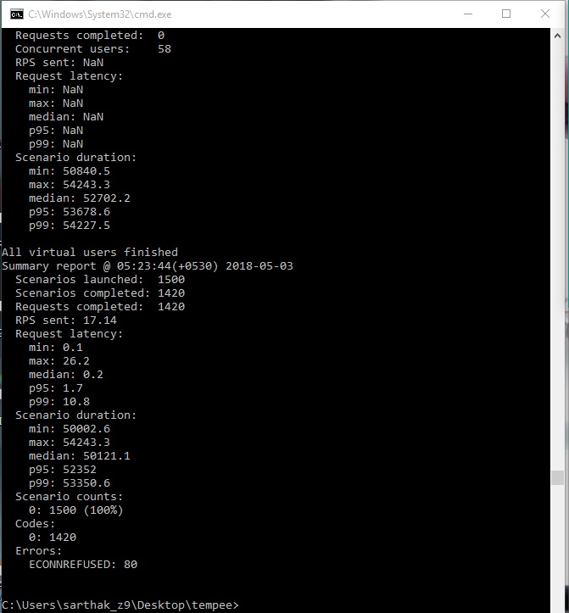
performing a Load test of 1500 sockets

Slide 18

Messaging queue

Slide 19
Case-2

Slide 20
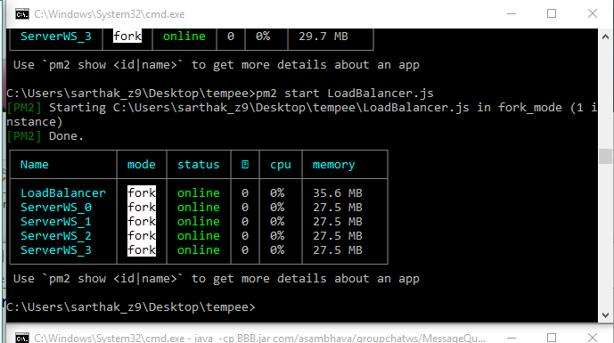
Using multiple instance (four) and a Load Balancer

Slide 21
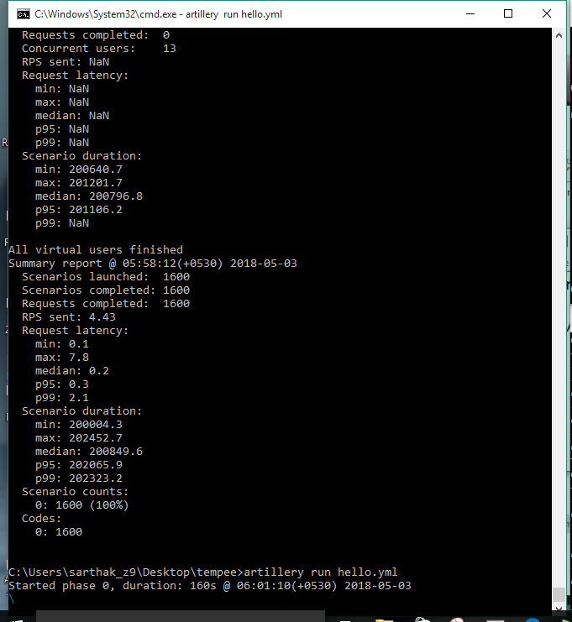
performing a Load test of 1600 sockets

Slide 22
WebLogic Server Clusters to Improve Performance

Slide 23
A WebLogic Server cluster is a group of WebLogic Servers instances that together provide fail-over and replicated services to support scalable high-availability operations for clients within a domain. A cluster appears to its clients as a single server but is in fact a group of servers acting as one to provide increased scalability and reliability.

Slide 24
A domain can include multiple WebLogic Server clusters and non-clustered WebLogic Server instances. Clustered WebLogic Server instances within a domain behave similarly to non-clustered instances, except that they provide failover and load balancing. The Administration Server for the domain manages all the configuration parameters for the clustered and non-clustered instances.

Slide 25
Scalability and High Availability:

Slide 26
Scalability is the ability of a system to grow in one or more dimensions as more resources are added to the system. Typically, these dimensions include (among other things), the number of concurrent users that can be supported and the number of transactions that can be processed in a given unit of time

Slide 27
Given a well-designed application, it is entirely possible to increase performance by simply adding more resources. To increase the load handling capabilities of WebLogic Server, add another WebLogic Server instance to your cluster—without changing your application. Clusters provide two key benefits that are not provided by a single server: scalability and availability.

Slide 28
How to Ensure Scalability for WebLogic Clusters

Slide 29
In general, any operation that requires communication between the servers in a cluster is a potential scalability hindrance. The following sections provide information on issues that impact the ability to linearly scale clustered WebLogic servers:

Slide 30
1. Database Bottlenecks 2. Session Replication 3. Invalidation of Entity EJBs 4. Invalidation of HTTP sessions 5. JNDI Binding, Unbinding and Rebinding

Slide 31
THANKS

